Slide 1


Battle of Neighborhoods
Find a Housing Area in New York

Slide 2

Objective
Collecting Neighborhood’s top trending venues using Foursquare API(Beautiful Soup, http request)
Forming neighborhood clusters based on venue categories using unsupervised k-mean clustering algorithm(sklearn)
Identifying and understanding the similarities and dissimilarities between two chosen neighborhoods to retrieve more insights and to conclude with ease which neighborhood wins over other.

Slide 3

Python packages and Dependencies:
Pandas - Library for Data Analysis
NumPy – Library to handle data in a vectorized manner
JSON – Library to handle JSON files
Geopy – To retrieve Location Data
Requests – Library to handle http requests
Matplotlib – Python Plotting Module
Sklearn – Python machine learning Library
Folium – Map rendering Library

Slide 4
Process to find Best neighborhood
Select
Select a Borough
Find
Find the best properties or cluster suited to your requirement
Select
Select the final neighborhood based on above
Explore
Explore the Population distribution of different neighborhood
Cluster
Cluster the neighborhood based on nearby avenues available

Slide 5
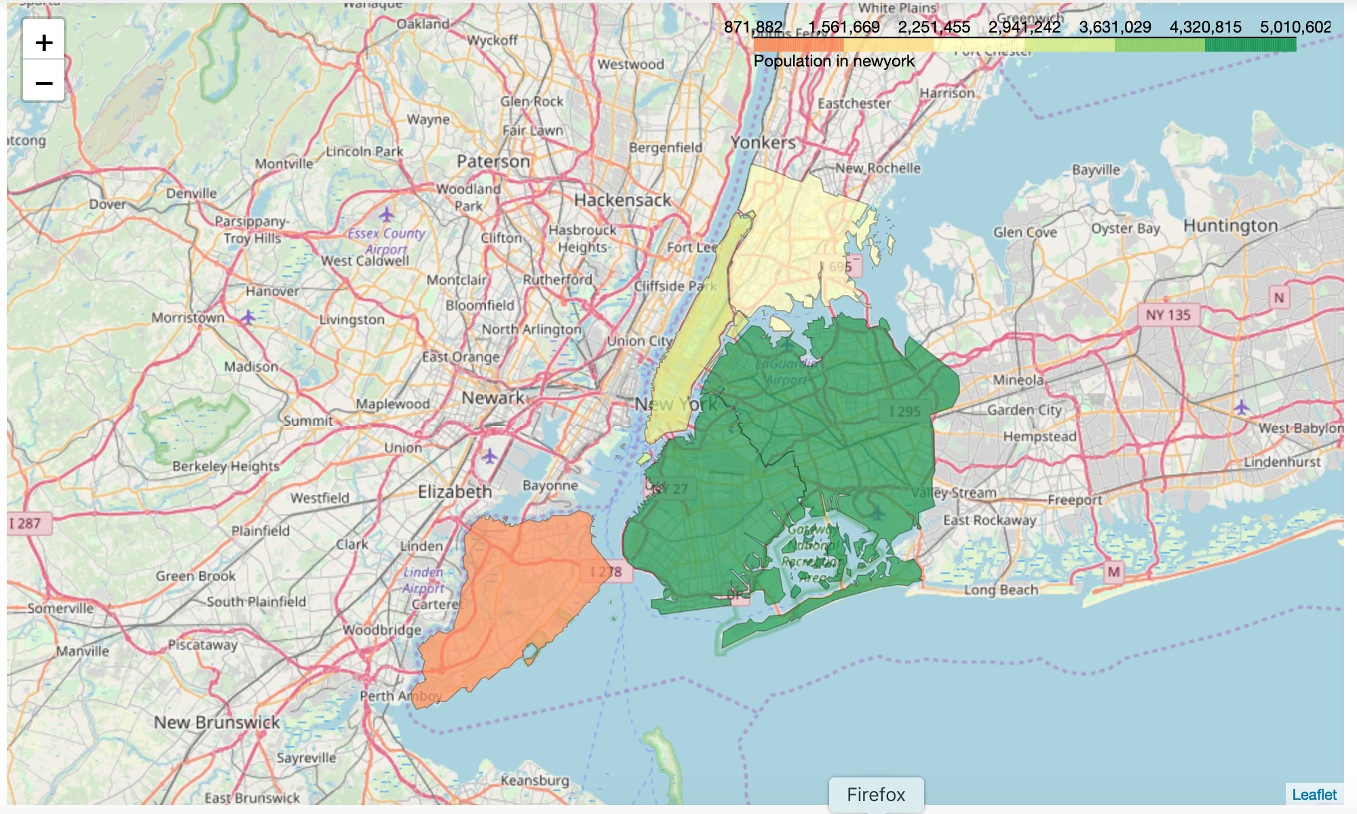
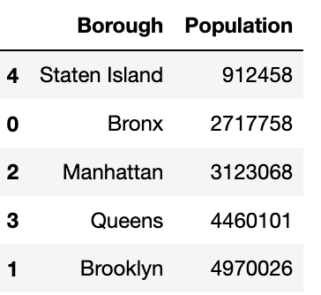
Borough Population distribution – folium map

Slide 6
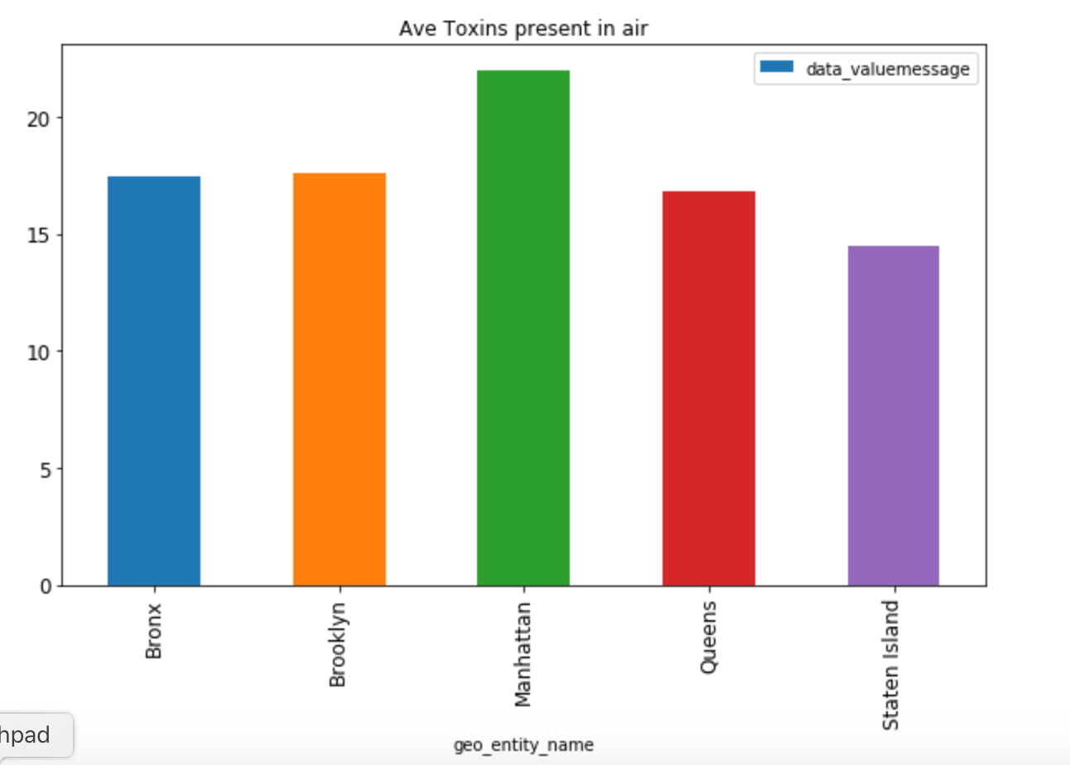
Average Toxins present in air
Max toxins are present in Manhattan area
Min toxin are present in Staten island

Slide 7
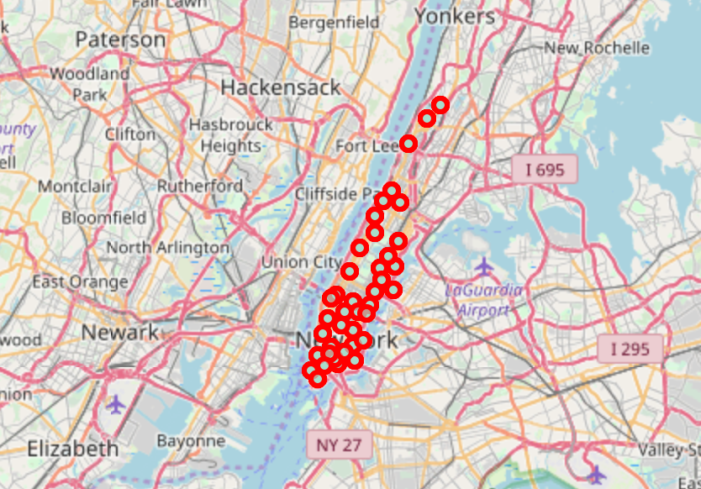
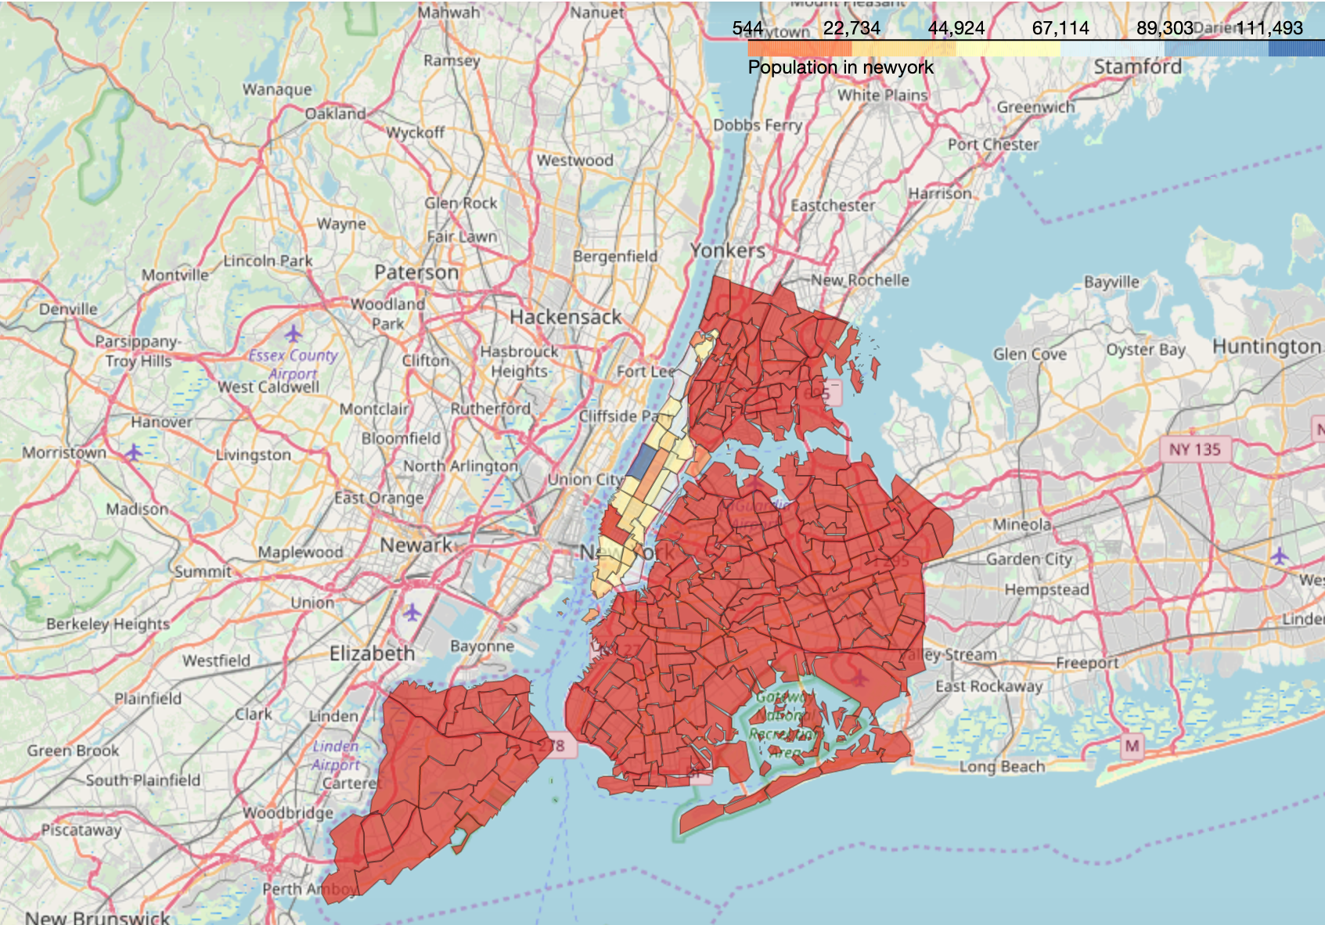
Neighborhood Population in manhattan

Slide 8
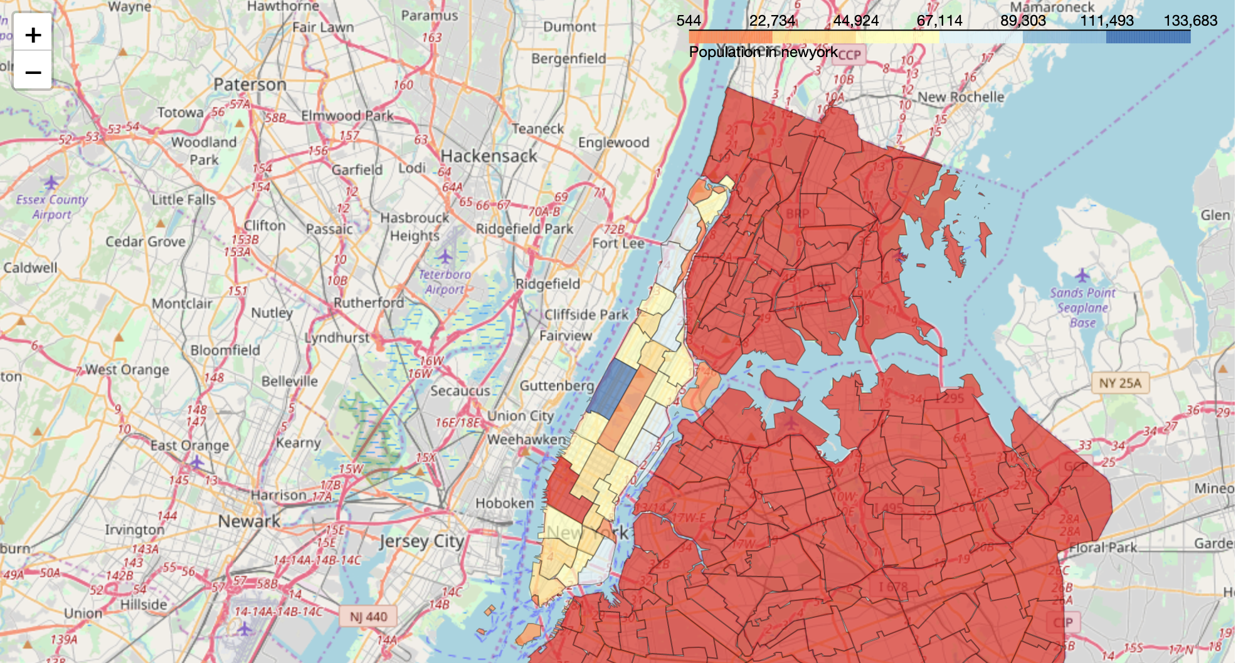
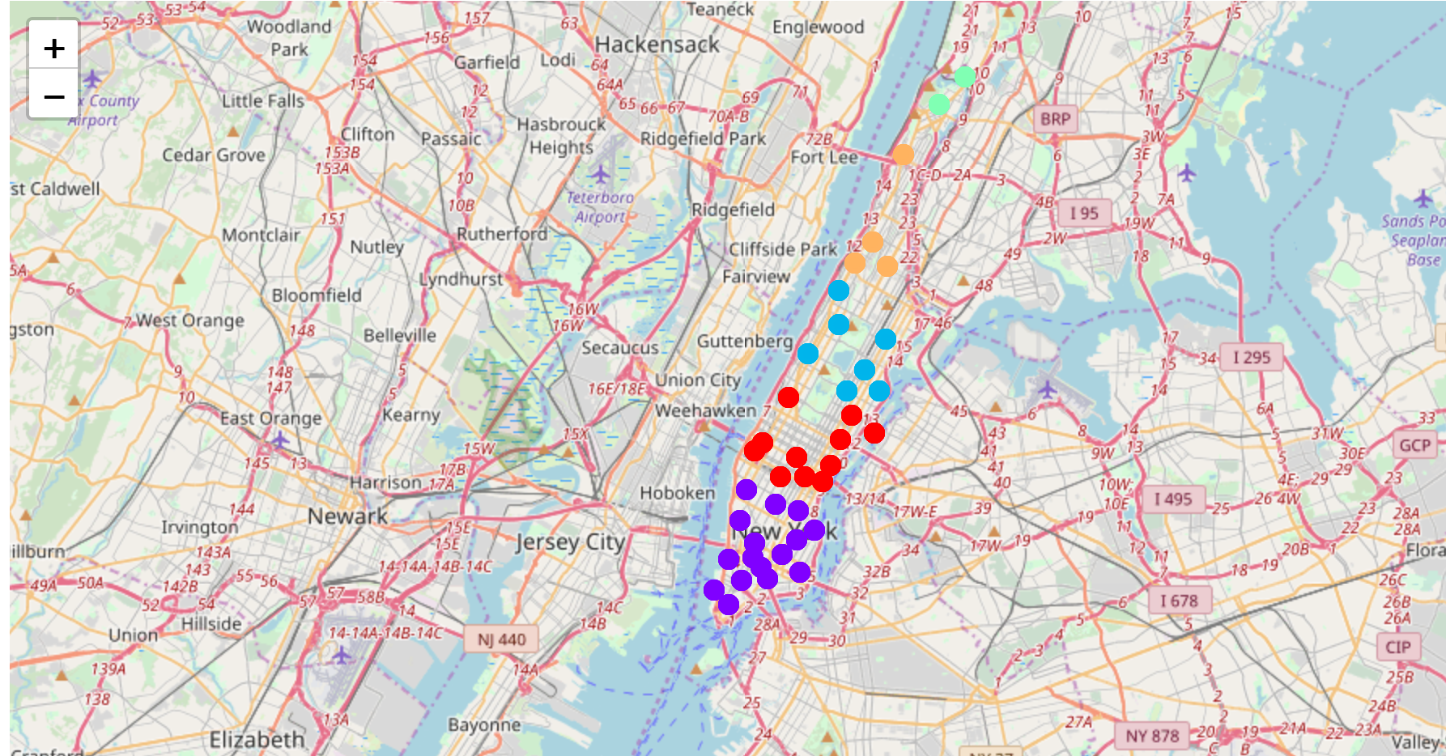
Population distribution and clustering by venues nearby

Slide 9
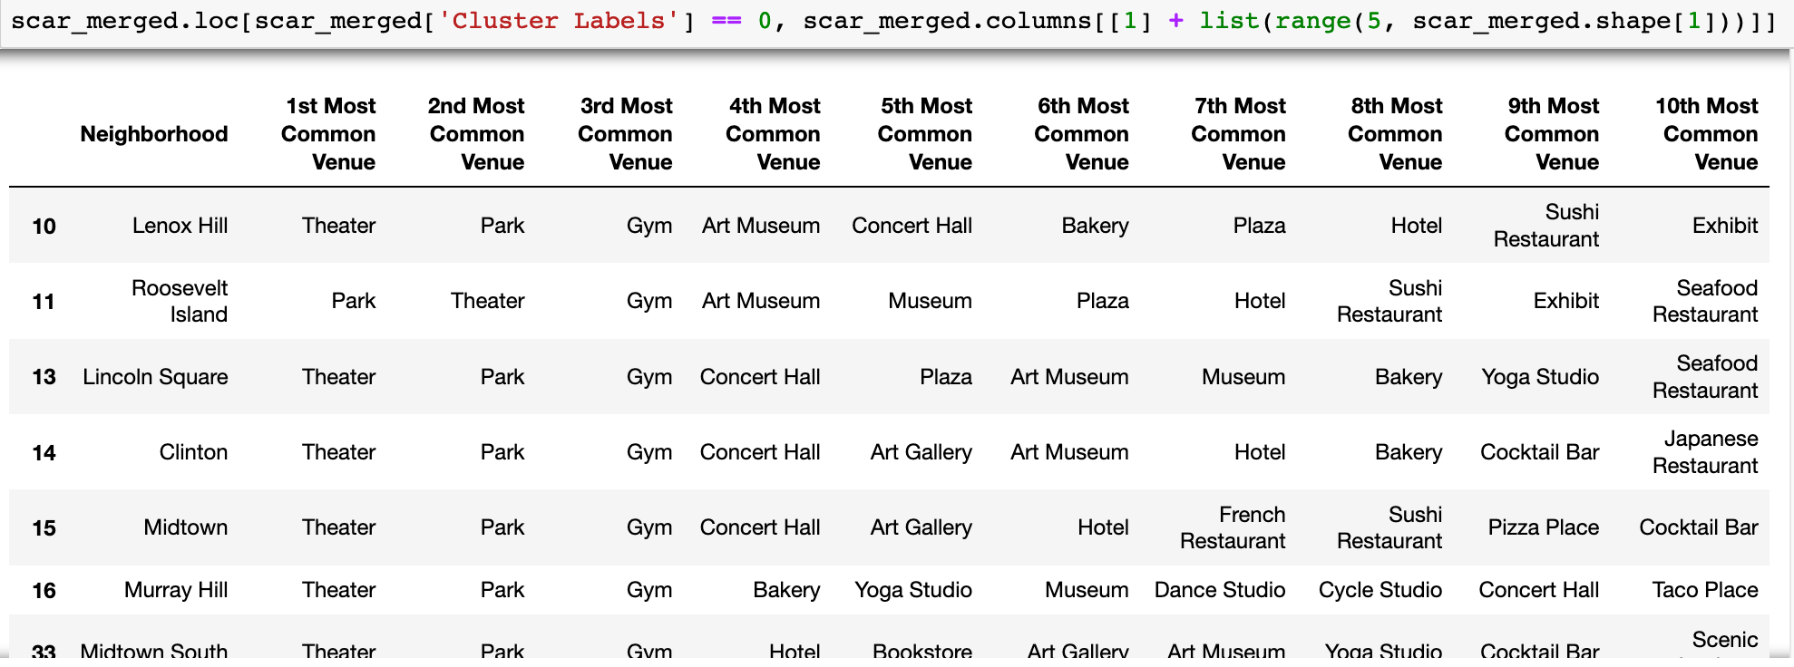
Exploring each cluster by venues nearby

Slide 10
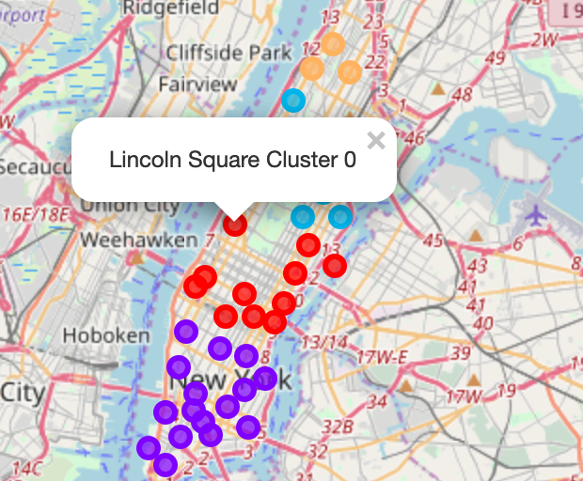
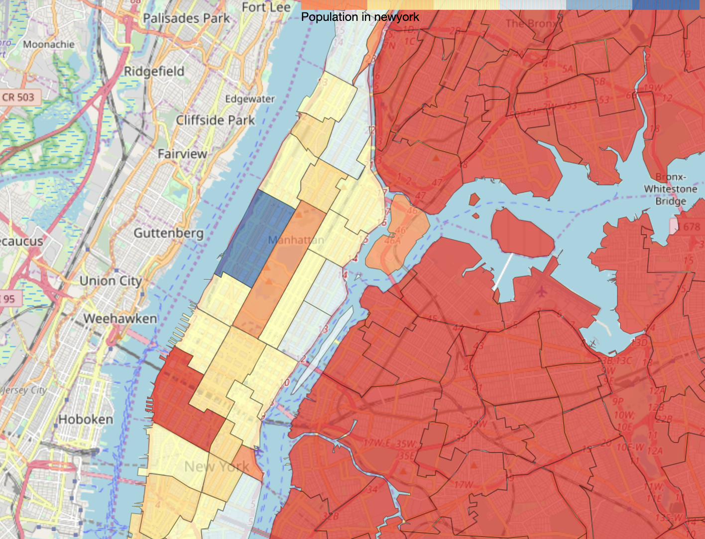
Best area to live is where cluster 0 is located. This is corroborated by population distribution map as well

Slide 11
conclusion
This Analysis shows the process to select a housing area in New York.
The maps help in finalizing a location with exploratory data analysis.
Further attributes can be added in the model to make it more customizable according to the need of future customers.

Slide 12
Thank you

